Slide 1
Research Access to JHM Data: HIPAA, Data Use, and the Data Trust
Valerie Smothers, Data Trust Administrator
Prepared for JHURA Brown Bag
February 9, 2022

Slide 2
Overview
Introduction to the JHM Data Trust and why it was created
HIPAA concepts and vocabulary
Guidance for accessing JHM data
Best practices for data storage and analysis
Discussion

Slide 3
The Data Trust

Slide 4
To bring together patient and member-related data from across the health system to support our mission.
Notes:
Prompted by Epic roll out. With advent of centralized data, needed centralized governance of clinical data. Evolving process.
The consolidation of clinical data in Epic introduces greater risk and greater opportunity. The Data Trust seeks to manage that risk while maximizing our opportunities.

Slide 5
Established by Policy, creating policy
https://hpo.johnshopkins.edu/
Notes:
Initially approved in 2016. The Data Trust governs the use and disclosure of JHM data.

Slide 6
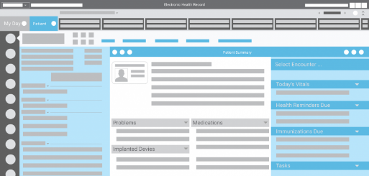
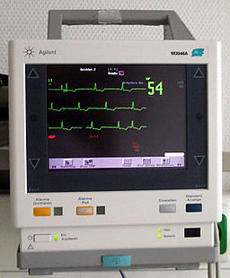
What is JHM Data?
Patient or member-related data stored in our clinical enterprise systems.
Billing, finance, health plan, and clinical administrative records or systems.
Patient monitoring data collected for clinical purposes.
$

Slide 7
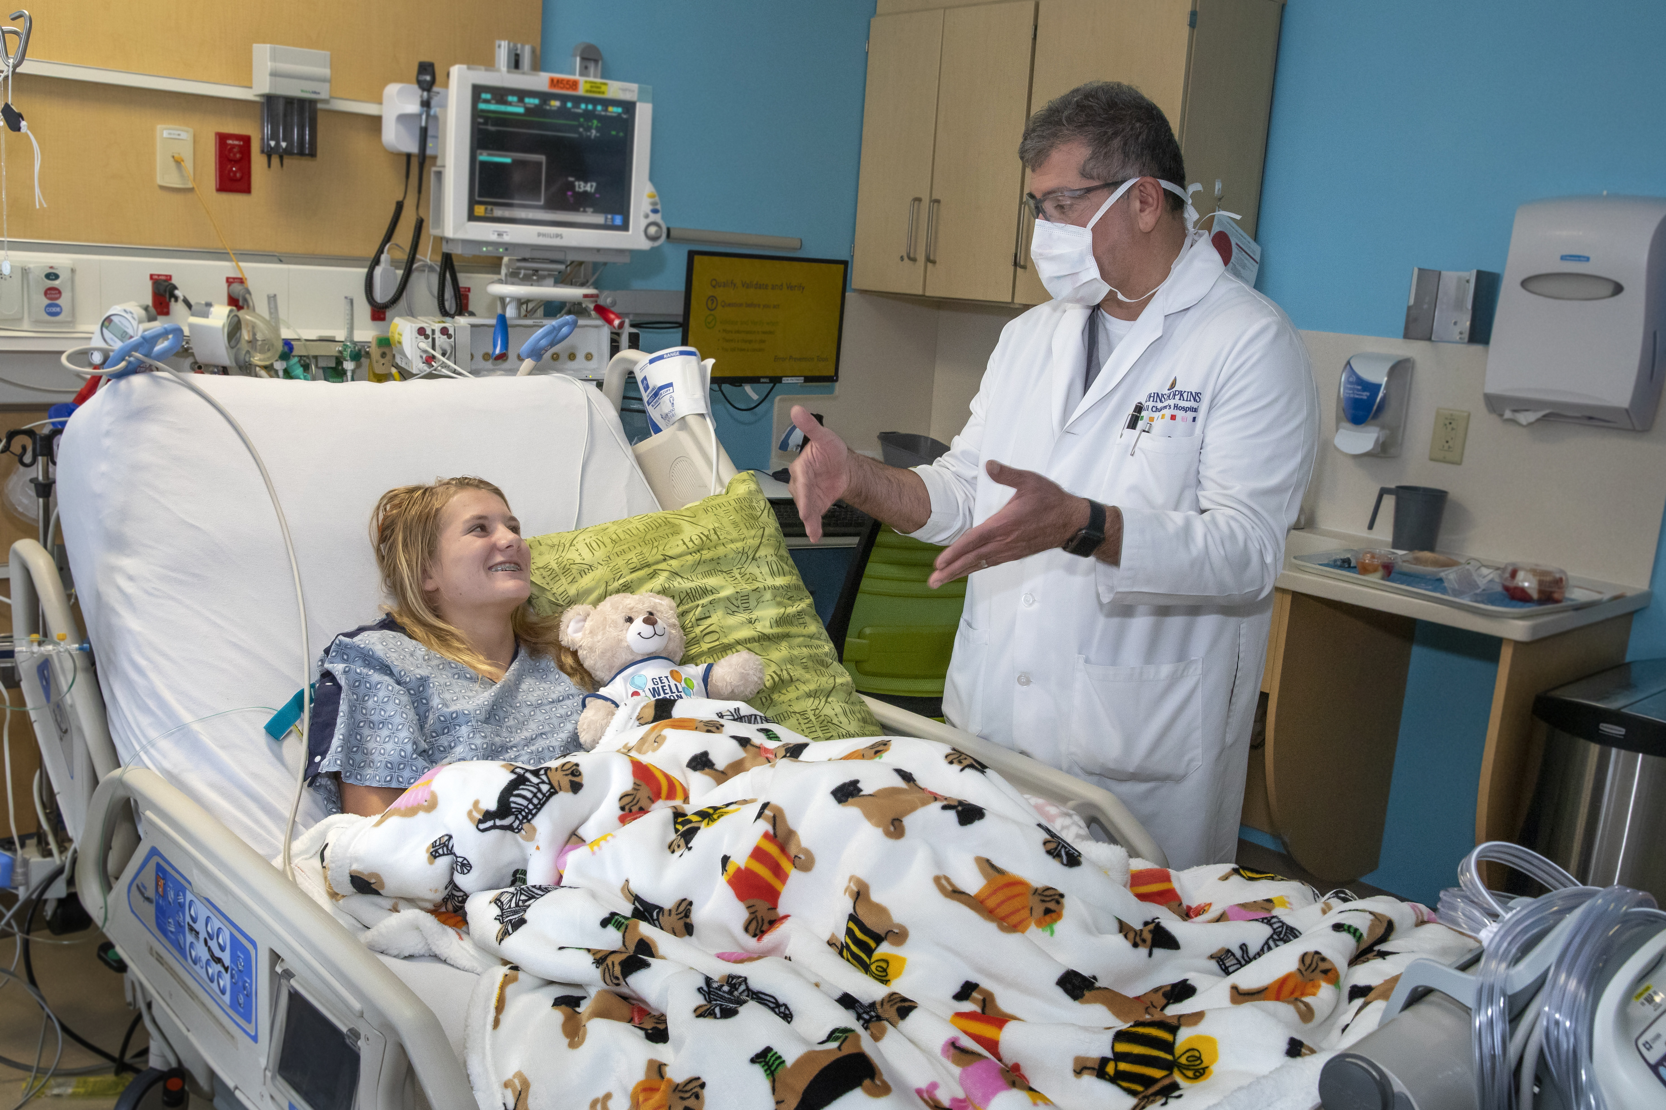
Ensuring the best use
Our patients entrust us with their care and data
We ensure good stewardship of their data, enabling its use for important research and innovation with appropriate protections

Slide 8
Patient data is a valuable asset for research
We want JHU researchers to be able to effectively leverage JHM patient data for important research.
Regulation and policies make the process somewhat complex.
We are working to simplify and guide JHU researchers through this process.

Slide 9
New Guidance
?
Research Access to Patient Data for JHU Researchers Outside of the JHM Covered Entity

Slide 10
HIPAA Concepts and Vocabulary

Slide 11
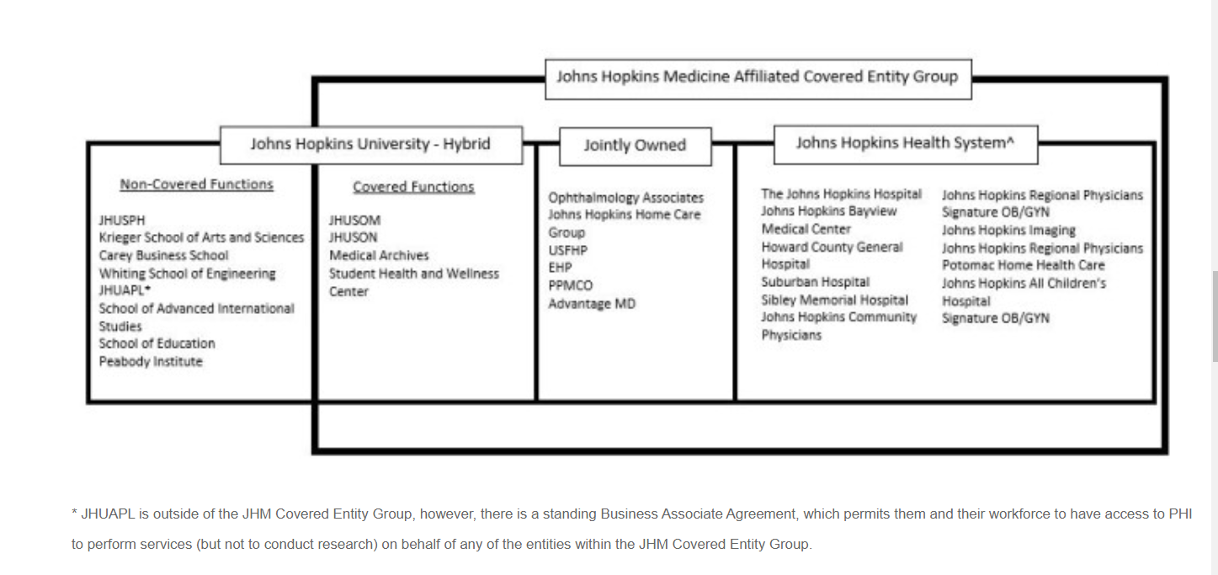
Care provider
https://intranet.insidehopkinsmedicine.org/privacy_office/about_hipaa/

Slide 12
Key Terms
PII | Personally Identifiable Information Information that can be used to identify an individual, whether on its own or in combination with other personal or identifying information.
PHI | Protected Health Information Health information that identifies a patient and relates to the condition of that patient or payment for health care to a patient.
LDS | Limited dataset, Health information w/o names and most other HIPAA identifiers. Dates, zip code, and age are ok.
De-identified | Health information that has had all 18 individual identifiers removed so that the patient cannot be identified by the remaining information.
See HIPAA Definitions , Privacy Office Glossary, and PII policy

Slide 13
Key Terms and Concepts
DUA | Data Use Agreement. Required for sharing LDS outside of covered entity.
Disclosure | Access to “facial” identifiers (name, mrn, address, etc.) outside the covered entity.
Authorization | Individual consent for the use or disclosure of PHI.
Minimum necessary | Without patient authorization, HIPAA mandates that disclosure of PHI for research purposes be the minimum necessary to conduct the research.
Waiver | HIPAA Waiver of Authorization. Must be approved by the IRB.
See Access to Patient Data for Research: Frequently Asked Questions
Note: Authorization enables sharing of PHI! Studies involving prospective collection of data can seek patient consent and authorization for the disclosure.
?

Slide 14
Guidance for accessing JHM data

Slide 15
Data Protection Attestation
Integrated into SOM e-IRB and SPH PHIRST
Serves as a DUA
You attest when you agree to serve as a study team member or PI

Slide 16
An Exception - APL
APL is a different legal entity, so the process is different.
APL researchers receiving JHM data that constitutes a limited dataset or PHI need a DUA.
APL researchers receiving a limited dataset through PMAP may use the APL Master DUA.

Slide 17
Get a Specification
Obtain or create a Data Specification, and include in the IRB application.
If you get data from Epic or other clinical system, the Core for Clinical Research Data Acquisition (CCDA) must provide.
If you get data from an IRB-approved protocol, the PI must provide.
Use limited to the research project.

Slide 18
Consider…
What kind of data am I accessing?
PHI?
LDS?
De-identified?
HIPAA
?

Slide 19
De-identified data
If CCDA de-identifies, and the spec indicates that, nothing else needed.
If the JHM study team de-identified prior to sharing, the CCDA must approve the de-identification plan. Upload their approval to IRB application.
EASIEST PATH

Slide 20
LDS – other JHU schools outside JHM
If CCDA provides the LDS, nothing else is needed.
If the JHM study team receives PHI and shares an LDS, specify what is shared in the data specification.
If data is not provided by CCDA certified data manager, obtain verification of limited dataset from a CCDA adjunct or team member certified in de-identification (see list).

Slide 21
LDS - APL
If using Master DUA, contact Suma Subbarao for pre-review and include the DUA attachment in§20 q2.
If not using master, PI contacts their department’s grants and contracts analyst to request DUA assistance.
If the JHM study team receives PHI and shares an LDS, specify what is shared in the data specification.

Slide 22
PHI
If patients consent to the research, ensure that the consent specifies data will be shared with JHU or APL collaborators outside the covered entity.
If unconsented (ie waiver),
Provide scientific justification for the disclosure
Whether the individual receiving PHI has unique qualifications not existing in the JHM Covered Entity
For sharing with APL, PI contacts their department’s grants and contracts analyst to request DUA assistance.
?

Slide 23
Best Practices

Slide 24
Best Practices
Best Practices for Storage of Data for Research and Quality Improvement

Slide 25
SAFE Desktop
Secure Analytic Framework Environment
Windows 10 virtual desktop
Accessible from any device, any location
Installed with SAS, Stata, RStudio, Python, MS Office, web browsers
100 GB secure data storage to share with study team
Data Trust approved, suitable for PHI
Free to all with a JHED ID
Data stays within JHU
https://ictr.johnshopkins.edu/safe-desktop
Notes:
If you can leverage the tools and data storage is sufficient, first choice for analysis.

Slide 26
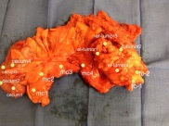
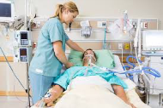
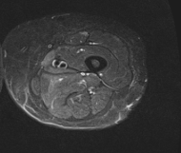
Precision Medicine Analytic Platform (PMAP)
DATA SOURCES
DISCOVERY
FUTURE
DELIVERY
Pathology
DATA COMMONS
RESEARCH ENVIRONMENT
TREATMENT PLATFORM
Epic
Hosts all data coming into platform from various, disparate data sources
Secure user environment with aggregated data sets approved for user – allows advanced analytics and other tools to be applied to data
Shared Algorithms, Analytics, Clinical Care Impact, Products
Commercialize
Reusable Pipelines
IRB
Approvals
Validation/
Promotion Process
Radiology
.
.
.
Includes local databases
Feedback
https://pm.jh.edu/
26
Courtesy Diana Gumas
Notes:
Appropriate for registries, larger datasets, or projections of existing PMAP registries. Suitable for PHI. Enables advanced analytics and collaboration with APL. Tools available for working with data in PMAP.

Slide 27
JHU REDCap
Data Trust approved, suitable for PHI
Research and QI Projects
Data collection
Chart review and annotation
Surveys
Single and Multi-site projects
Can be used with SAFE
https://redcap.jhu.edu/

Slide 28
Other Best Practices
Sharing with other institutions
Biospecimens
High Performance Computing
JH OneDrive (configured securely)
Open Specimen
Phoneix (PHI)
MARCC (not PHI)

Slide 29
Resources
Research Access to Patient Data for JHU Researchers Outside of the JHM Covered Entity
Access to Patient Data for Research: Frequently Asked Questions
Sharing JHM Data
Research Data Subcouncil
Best Practices for Storage of Data for Research and Quality Improvement

Slide 30
Notes:
Questions- Sara

